Slide 1
Final Review
Jun Xu
CS-392 Systems Programming
Spring 2019

Slide 2
Final Exam Arrangements
Format: Paper Exam
Time: May 15th, Wed, 10:00 – 12:00 AM
Location:
Babbio Center BC310: All students in Section A + The following students from Section B:
Daniel Barry
Tarquin Bennett
Alejandro Brancale
Matthew Brand
Morgan Brenner
Jared Bridges
Edwin A. Stevens E330: All the other students in Section B

Slide 3
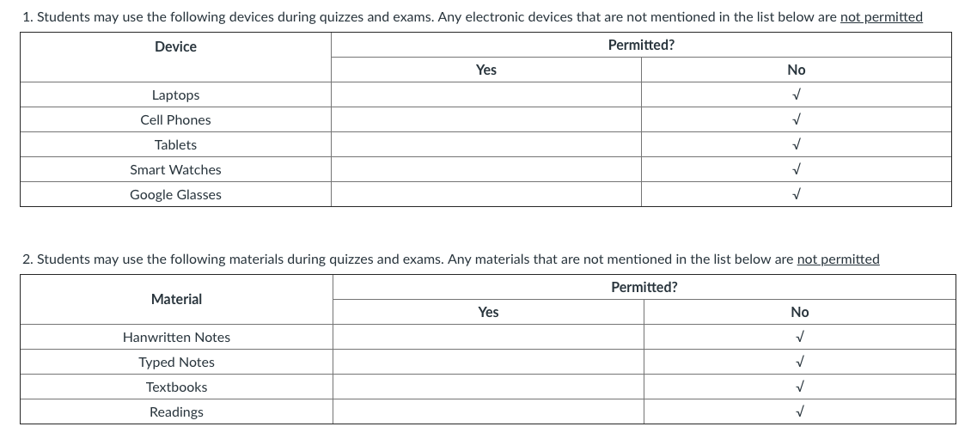

Slide 4
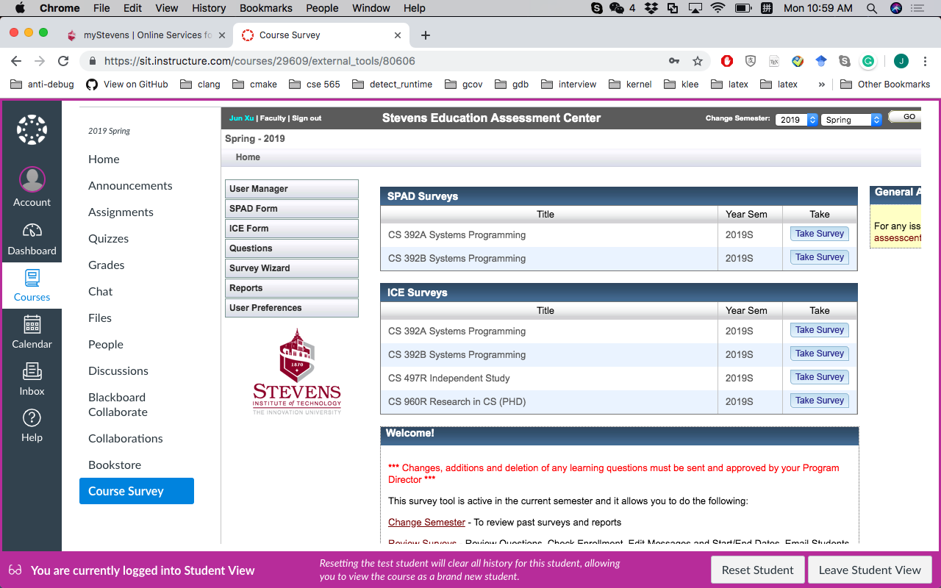
Please Help Do the Course Surveys

Slide 5
LEARNING OBJECTIVES
CS392
Understand Linux environments (including Linux commands)
Create C programs that conform to the specification of Linux platform. Include C grammars, compiling, and linking.
Use Makefiles, debugging tools like gdb, and version control (github or something similar).
Develop applications that perform file access.
Create a client/server based application using sockets.
Develop applications that create new processes and communicate with each other through pipes and signals. Understand the different states of a process.
Understand system calls, memory management, and user permissions (including setUID/setGID).

Slide 6
Part 1 -- Linux
CS392

Slide 7
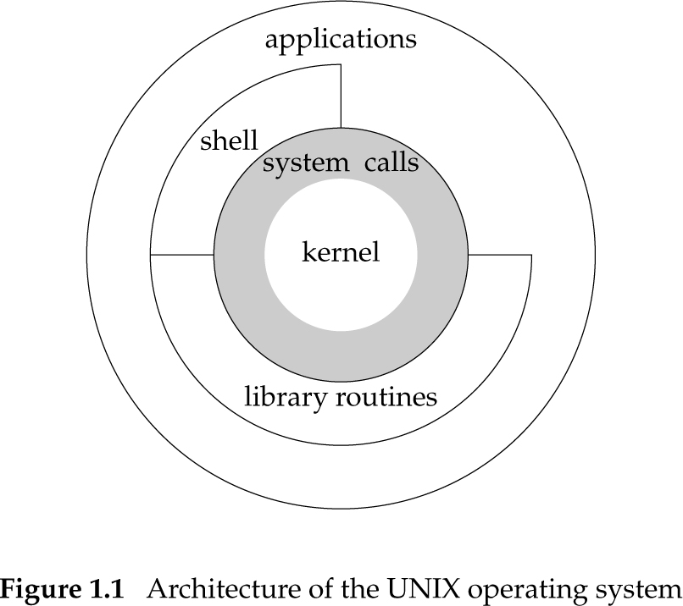
Computer Systems
CS392
Computer system
The complete computer made up of the CPU, memory and related electronics (main cabinet), all the peripheral devices connected to it and its operating system
Operating system
A software system that manages computer hardware and software resources and provides common services for computer programs

Slide 8

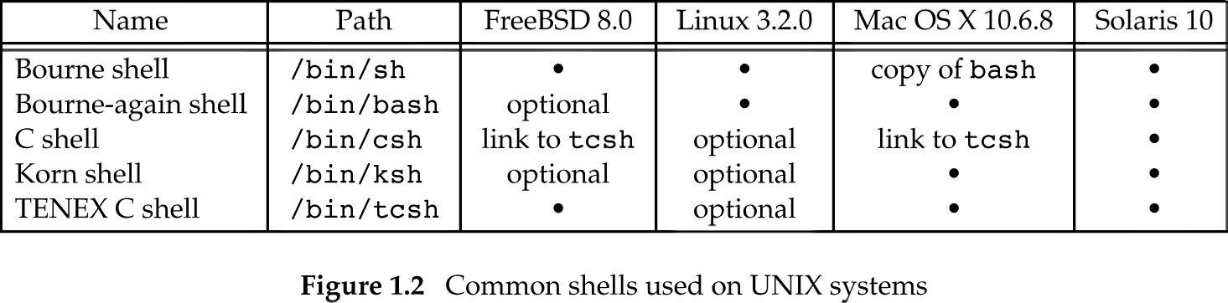
Work with Terminal: Shells
In our VM, the default shell is bash: https://www.gnu.org/software/bash/manual/bashref.html#What-is-a-shell_003f
CS392

Slide 9
Shell Commands
CS392
Shell Built-in Commands
The shell implements them
Small in number
E.g., cd
User Commands
Programs installed in the system
Usually in /bin or /bin/usr
Frequently used
Many in number
Your shell needs to know where to find them

Slide 10
Part 2 – C Basics
CS392

Slide 11
Be Aware of Different Standards
ANSI C (ISO C)
Successive standards for the C programming language
C89, C90, C95, C99, C11, C18
POSIX --- Portable Operating System Interface
The application programming interface (API)
Standard C library
CS392

Slide 12
Primitive Types in C Language
int – integer
float – floating point number
char -- character - a single byte (it is actually a number)
short -- short integer
long -- long integer
double -- double-precision floating point
Types can also by unsigned!
No bool type!
CS392

Slide 13
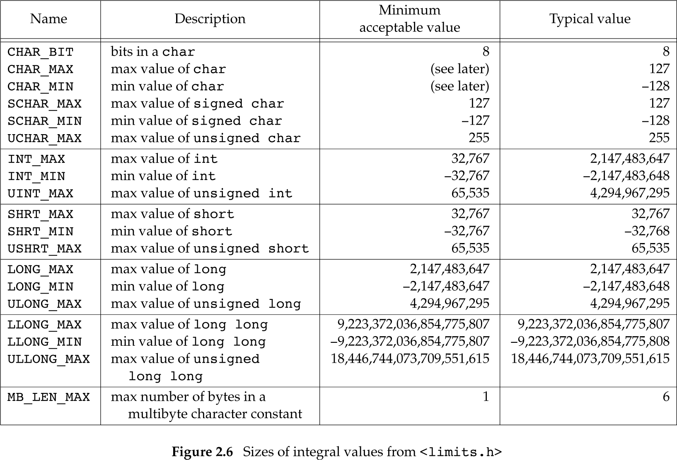
Typical Type Limits
CS392

Slide 14
Implicit and Explicit Typecasts
CS392
int main(int argc, char** argv){
char var1 = 0x41; // typecast: 0x41 -> “A”
int var2 = 1.5; // typecast: 1.5 -> 1
unsigned int var3 = -1; // typecast: -1 -> 0xffffffff
float var4 = (float)1; // typecast: 1 -> 1.0
}
char c = 0x41424344;
What is the value of c?

Slide 15
Constants by Macro
CS392
Define using #define <name> <replacement text>
Example: #define PI 3.14
The pre-processor will replace every instance of PI with 3.14 before passing your source code to the compiler
#define PI 3.14
int main(int argc, char** argv){
float pi = PI; // pi = 3.14
return 1;
}

Slide 16
Enumerations
CS392
Organize multiple constants together
The first member has value 0, the next 1, and so on
Unless explicitly specified
Examples:
enum boolean { NO, YES };
Defines NO as 0 and YES as 1
enum months { JAN = 1, FEB, MAR, … };
enum escapes { BELL = ‘\a’, BACKSPACE = ‘\b’, … };

Slide 17
Structures
CS392
Structure is a collection of variables (can be of different types) under a single type.
Similar to class in C++/Java/Python
There is no class in C
struct my_struct {
int x;
int y;
int z;
} ;

Slide 18
Arrays
CS392
An array is a collection of data items, all of the same type, accessed using a common name
Array can be multi-dimensional
int a[10]; // type name[size1]
char b[10][100];
struct my_struct c[10][100][1000];

Slide 19
Pointers
CS392
A pointer is a data object that stores the memory address of another data object located in computer memory.
int *intptr;
char *charptr;
struct my_struct *structptr;
int **intptrptr

Slide 20
Pointers
CS392
Pointer types store an address of memory
(Usually) an unsigned long integer
When dereferenced (operator *) they return the contents of what they point to according to the pointer type
For example, an integer pointer returns an int
int a, b, c, *p;
a = 1;
p = &a;
*p = 2;
&a
2
p
a
b
c

Slide 21
Pointer Arithmetic
CS392
You can add or subtract an integer from a pointer
You can also use the ++ / -- operators
You can subtract two pointers
int a[10], *pa, b;
pa = a;
b = *(pa + 1);
int a[10], *pa, b;
pa = &a[0];
b = a[1];
These are functionally equivalent.

Slide 22
Variable Scope
CS392
Local – variables valid within functions
Defined within the function before use
Allocated in the program’s stack by the compiler
Prefer to define at the top of the function
int func1(int c){
int i;
i = 1;
}
int func2(int c){
i = 1; //Wrong scope
}

Slide 23
Variable Scope
CS392
Global – variables accessible by the entire program
Defined outside functions
int g_debug_level;
int func1(int c){
g_debug_level = 1;
}
int func2(int c){
g_debug_level = 2;
}
int func3(int c){
g_debug_level = 3;
}

Slide 24
Variable Scope
CS392
Static – variables accessible only within the file they were defined in
Defined outside functions
They can actually be accessed by the whole program, if it can find them. It is only programmatically that they are inaccessible to other files.
Can only be initialized by constants literals
Initialized as 0 if not explicitly assigned
static int g_debug_level; //file1.c
int func1(int c){ //file1.c
g_debug_level = 1; // OK
}
int func2(int c){ //file2.c
g_debug_level = 2; // Not OK
}
You may also see this:
int func3(int c){
int var_1 = 0
static int var_2 = 1;
}
How var_1 differs from var_2?
//var_2 only initializes once

Slide 25
Strings in C Program
CS392
Strings
Arrays of characters terminated by the null character ‘\0’
Also called null-terminated strings
Examples:
char str[10];
A string that fits 9 characters + the terminating null character
char str[] = “Hello, world!”
str is automatically allocated to hold the string + the terminating null character
char *str = “Hello, world!”

Slide 26
String Operations (1)
CS392
Copying:
void* memcpy (void* dest, void* src, size_t n);
copy n bytes of src into dest, return dest
char* strcpy(char* dest, char* src);
copy src string into dest, return dest (stop when encountering ‘\0’)
Concatenation:
char * strcat (char * dest, char* src);
append copy of src to end of dest, return dest (‘\0’ of dest is overwritten)
Comparison:
int strcmp (char * str1, char * str2);
compare str1, str2 by character (based on ASCII value of each character, then string length), return comparison result
str1 < str2: -1
str1 == str2: 0
str1 > str2: 1

Slide 27
String Operations (2)
CS392
Searching:
char* strstr (char * str1, char * str2);
return pointer to first occurrence of str2 in str1, else NULL
char* strtok (char * str, char * delimiters);
tokenize str according to delimiter characters provided in delimiters, return the next token per successive stroke call, using str = NULL
Other:
size_t strlen ( const char * str );
returns length of the string (up to, but not including the ‘\0’ character)
void * memset (void* ptr, int val, size_t n );
set first n bytes of memory block addressed by ptr to val

Slide 28
Dynamic Memory Allocation/Free
void *malloc(size_t size);
The malloc() function allocates size bytes and returns a pointer to the allocated memory. The memory is not initialized. If size is 0, then malloc() returns either NULL, or a unique pointer value that can later be successfully passed to deallocation
void free(void *ptr);
The free() function frees the memory space pointed to by ptr, which must have been returned by a previous call to malloc(), calloc() or realloc(). Otherwise, or if free(ptr) has already been called before, undefined behavior occurs. If ptr is NULL, no operation is performed.
CS392

Slide 29
Dynamic Memory Allocation/Free
#include<stdio.h>
int main(int argc, char ** argv){
char *ptr;
int sz;
FILE *fp = fopen(“/path/to/your/file”, “r”); // we do not know the size of this file
fseek(fp, 0L, SEEK_END);
sz = ftell(fp);
rewind(fp); //move the position indicator back the to file beginning
ptr = malloc(sz); // we dynamically allocate a memory with size of the file
fread(ptr, 1, sz, fp);
free(ptr); //free the memory we allocated
fclose(fp);
}
CS392

Slide 30
Header Files
CS392
Each header file contains one or more function declarations, data type definitions, and macros.
Good place to declare your own functions, types, and macros
Try to avoid defining variables or functions inside
#include<stdio.h> // this header includes declaration of printf. Try “whereis stdio” in shell
int main(int argc, char ** argv){
printf(”Hello World\n”);
return 1;
}

Slide 31
Create Your Own Header File
Use “#ifdef” and “#ifndef” to avoid duplicated include
“#ifdef” and “#ifndef” are used in pre-processing by compilers
//myheader1.h
#ifndef MY_HEADER1_H
#define MY_HEADER1_H
extern int g_log_level;
void log_to_file(int );
typedef unsigned int uint;
#define CONSTANT 1000
#endif
//main.c
#include “myheader1.h” // This defines MY_HEADER1_H
#include “myheader2.h” // myheader1.h will not be included int main(int argc, char**argv){
return 0;
}
//myheader2.h
#ifndef MY_HEADER2_H
#define MY_HEADER2_H
#include “myheader1.h”
#define LOG_LEVEL g_log_level
#endif
CS392

Slide 32
Part 3 – Compiling and linking
CS392

Slide 33
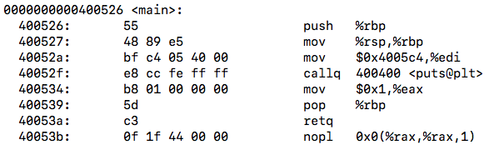
Compiling
CS392
Compiling is a process that transforms computer code written in one programming language (the source language) into another programming language (the target language).
For CS392, compiling is to transform Linux C code to binary code
#include<stdio.h>
int main(int argc, char** argv){
printf(“Hello World\n”);
return 1;
}
Source Code
Binary Code

Slide 34
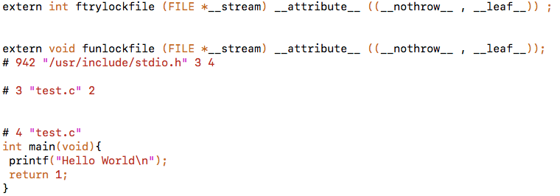
Compiling (1): Pre-processing
Pre-process the directives
Expand the #include and #define
Human readable source code
gcc main.c –E main.i or cpp main.c –o main.i
CS392
#include<stdio.h>
int main(int argc, char** argv){
printf(“Hello World\n”);
return 1;
}
main.i
main.c

Slide 35
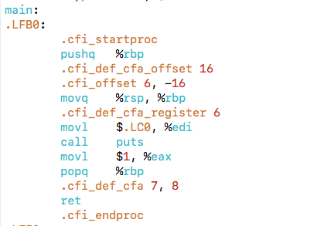
Compiling (2): Compilation
Translates the pre-processed source code into assembly code
Human readable machine code
gcc –S main.i –o main.s
CS392
main.i
main.s

Slide 36
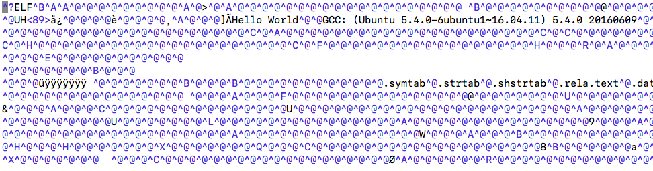
Compiling (3): Assemble
Translates the assembly code into machine code
Machine code
gcc -c main.s -o main.o or as main.s –o main.o
CS392
main.s
main.o

Slide 37
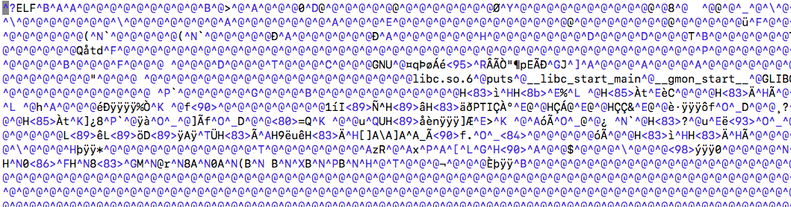
Compiling (4): Linking
CS392
Links object files to produce final executable file.
Executable machine code
gcc main.o -o main
main.o
main

Slide 38
Compiling A Program with Multiple Files
CS392
main.c
sum.c
Source files
Translators
(cpp, cc1, as)
Translators
(cpp, cc1, as)
Separately compiled
relocatable object files
(gcc –c file.c –o file.o)
main.o
sum.o
Linker (ld)
Fully linked executable object file
(contains code and data for all functions
defined in main.c and sum.c)
prog

Slide 39
How Linker Resolves Duplicate Symbol Definitions
Program symbols are either strong or weak
Strong: procedures and initialized globals
Weak: uninitialized globals
CS392
p1.c
p2.c
strong
int foo=5;
p1() {
}
int foo;
p2() {
}
weak
strong
strong

Slide 40
Linker’s Symbol Rules
Rule 1: Multiple strong symbols are not allowed
Each item can be defined only once
Otherwise: Linker error
Rule 2: Given a strong symbol and multiple weak symbols, choose the strong symbol
References to the weak symbol resolve to the strong symbol
Rule 3: If there are multiple weak symbols, pick an arbitrary one
Can override this with gcc –fno-common
CS392

Slide 41
Linker Puzzles
CS392
int x;
p1() {}
p1() {}
Link time error: two strong symbols (p1)
int x;
p1() {}
int x;
p2() {}
References to x will refer to the same
uninitialized int. Is this what you really want?
int x;
int y;
p1() {}
double x;
p2() {}
Writes to x in p2 might overwrite y!
Evil!
int x=7;
int y=5;
p1() {}
double x;
p2() {}
Writes to x in p2 will overwrite y!
Nasty!
int x=7;
p1() {}
int x;
p2() {}
References to x will refer to the same initialized
variable.

Slide 42
Creating Static Libraries
CS392
atoi.c
printf.c
random.c
Translator
Translator
...
Translator
atoi.o
printf.o
random.o
Archiver (ar)
$ ar rs libc.a atoi.o printf.o … random.o
libc.a
C standard library
Archiver allows incremental updates
Recompile function that changes and replace .o file in archive

Slide 43
Linking with Static Libraries
linux> gcc -Og –static -o prog2c main2.o libvector.a
addvec.o
multvec.o
main2.c
vector.h
Archiver
(ar)
CS392
Translators
(cpp, cc1, as)
libvector.a
libc.a
Static libraries
Relocatable
object files
main2.o
addvec.o
printf.o and any other
modules called by printf.o
Linker (ld)
Fully linked
executable object file
prog2c
“c” for “compile-time”

Slide 44
Dynamic Linking
CS392
main2.c
vector.h
unix> gcc -shared -o libvector.so
addvec.c multvec.c
Translators
(cpp, cc1, as)
libc.so
libvector.so
Relocatable
object file
main2.o
Relocation and symbol table info
Linker (ld)
unix> gcc –O0 -o prog2
main.o libvector.so
Partially linked
executable object file
prog2
Loader (execve)
libc.so
libvector.so
Code and data
Fully linked
executable
in memory
Dynamic linker (ld-linux.so)

Slide 45
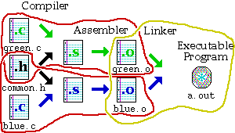
Makefiles
Provide a way for separate compilation.
Describe the dependencies among the project files.
The make utility.
CS392
Notes:
Makefiles provide a way for separate compilation. When a file from a project is changed, only the files that depend on the changed file are compiled.

Slide 46
Using makefiles
Naming:
makefile or Makefile are standard
other name can be also used
Running make
make
make –f filename – if the name of your file is not “makefile” or “Makefile”
make target_name – if you want to make a target that is not the first one
CS392

Slide 47
Sample makefile
Makefiles main element is called a rule:
Example:
my_prog : eval.o main.o
g++ -o my_prog eval.o main.o
eval.o : eval.c eval.h
g++ -c eval.c
main.o : main.c eval.h
g++ -c main.c
_________________________
# -o to specify executable file name
# -c to compile only (no linking)
target : dependencies
TAB commands #shell commands
CS392

Slide 48
Implicit rules
Implicit rules are standard ways for making one type of file from another type.
There are numerous rules for making an .o file – from a .c file, a .p file, etc. make applies the first rule it meets.
If you have not defined a rule for a given object file, make will apply an implicit rule for it.
Example:
Our makefile The way make understands it
my_prog : eval.o main.o
$(C) -o my_prog $(OBJS)
$(OBJS) : $(HEADERS)
CS392
my_prog : eval.o main.o
$(C) -o my_prog $(OBJS)
$(OBJS) : $(HEADERS)
eval.o : eval.c
$(C) -c eval.c
main.o : main.c
$(C) -c main.c

Slide 49
Part 4 – Standard IO
CS392

Slide 50
Standard Input
CS392
In Linux, stdin is defined by the POSIX standard.
Its default file descriptor number is 0. In the terminal, standard input defaults to the user’s keyboard.
int scanf(const char *format, ...);
Libc: scanf()
// hello.c
#include<stdio.h>
int main(int argc, char ** argv){
int var0;
char str[20];
scanf(“%d”, &var0)
//why & operator
scanf(“%s”, str);
scanf(“%d%s”, &var0, str);
return 1;
}
Syscall: read(fd = 0)
Kernel: read(fd = 0)
Hello, World

Slide 51
Other Standard Input Functions
CS392
int getchar(void);
Returns the next character from the standard input (stdin)
char *gets(char *str);
Reads a line from stdin into the buffer pointed to by str until either a terminating newline or EOF (Ctrl D in Linux), which it replaces with a null byte ('\0').
#include<stdio.h> //header files to include declaration of getchar and gets
int main(int argc, char ** argv){
char var_0;
char str[10]; // We use it as a string
var_0 = getchar();
gets(str);
//What if you type more than 9 bytes?
return 1;
}

Slide 52
Standard Output
CS392
In Unix-like operating systems, such as Linux, macOS X, and BSD, stdout is defined by the POSIX standard.
Its default file descriptor number is 1. In the terminal, standard output defaults to the user's screen.
Libc: printf()
// hello.c
#include<stdio.h>
int main(int argc, char ** argv){
printf(”Hello World\n”);
return 1;
}
Syscall: write(fd = 1)
Kernel: write(fd = 1)

Slide 53
Formatted Output
CS392
Format String
A control parameter used by a class of functions in the input/output libraries
Control the locations and methods to translate variables to characters.
int printf(const char *format, var1, var2, …); printf(”The variables are %c, %d, %lu \n”, var_0, var_1, var_2);
// each specifier(starting with %) will be replaced by the corresponding variable.
// This will print “The variables are A, -1, 2”
// hello.c
#include<stdio.h>
int main(int argc, char ** argv){
char var_0 = ‘A’;
int var_1 = -1;
unsigned long var_2 = 2;
printf(”The variables are %c, %d, %lu \n”, var_0, var_1, var_2);
// each specifier(starting with %) will be replaced by the corresponding variable.
// This will print “The variables are A, -1, 2”
return 1;
}

Slide 54
Other Standard Output Functions
int putchar(int c);
Write a single character to standard output
input puts(char* str);
Write a string to standard output
CS392
#include<stdio.h> //header files to include declaration of putchar and puts
int main(int argc, char ** argv){
char var_0 = ‘A’;
putchar(var_0);
puts(argv[0])
//argv[0] always points to the string containing the program name
return 1;
}

Slide 55
Standard Error
CS392
In Unix-like operating systems, such as Linux, macOS X, and BSD, stderr is defined by the POSIX standard.
Its default file descriptor number is 2. In the terminal, standard error defaults to the user's screen.
stderr is a data stream defined in stdio.h for standard error
Libc: fprintf(stderr)
// error.c
#include<stdio.h>
int main(int argc, char ** argv){
fprintf(stderr, “Something Wrong\n”);
return 1;
}
Syscall: write(fd = 2)
Kernel: write(fd = 2)
Something Wrong

Slide 56
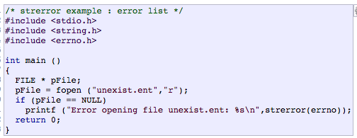
Errno (We have talked about it)
CS392
errno is a global integer variable set by libc functions
Whenever an error occurs it is set to a non-zero error number
It is never set to zero by libc, but you can modify it
Numbers are defined in errno.h
We can use errno -l to print the error message behind an error number
char *strerror(int errnum);
Return a pointer to a string describing the error behind errnum
CS392

Slide 57
perror()
CS392
void perror(const char *s);
Produces an error message including the string s, colon, and a description of the last error based on the error number stored in errno
perror(s) is equivalent to printf(“%s: %s\n”, s, strerror(errno));

Slide 58
Part 5 – File IO
CS392

Slide 59
Open a Stream
CS392
FILE *fopen(const char *path, const char *mode)
Opens the file/device whose name is in the string pointed to by “path”
The opened file/device is associated with a stream and represented by the returned FILE* pointer
The string pointed to by “mode” specifies the mode in which to open the file
// openfile.c
#include<stdio.h>
int main(int argc, char ** argv){
FILE *fp;
fp = fopen(“/path/to/your/file”, “r”);
//open the file at “/path/to/your/file” to read
return 1;
}
// openfile.c
#include<stdio.h>
int main(int argc, char ** argv){
FILE *fp;
fp = fopen(“/dev/stdin”, “r”);
//open the standard input device to read
//no difference from file based stream
return 1;
}

Slide 60
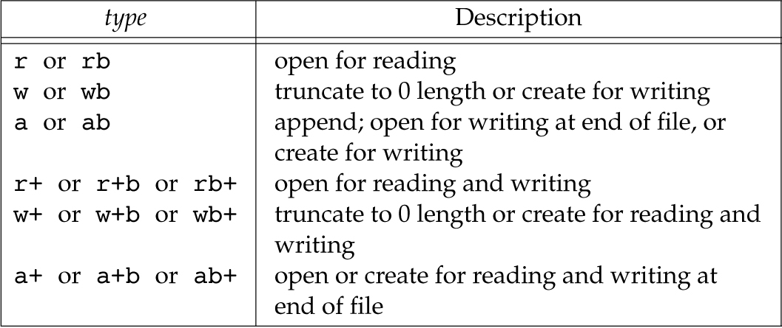
Stream Modes
CS392
UNIX does not treat binaries differently so in most cases using b does not affect the stream in any way, but it does increase code readability

Slide 61
Closing a Stream
CS392
int fclose(FILE *fp);
Flushes the stream pointed to by fp (writing any buffered output data using fflush(3)) and closes the underlying file descriptor
Warning: If you are writing or appending to a file remember to always close it or otherwise your changes may not be written to disk
// openfile.c
#include<stdio.h>
int main(int argc, char ** argv){
FILE *fp;
fp = fopen(“/path/to/your/file”, “r”);
fclose(fp); //close the opened stream
return 1;
}

Slide 62
Reopen a Stream
CS392
FILE *freopen(const char *path, const char *mode, FILE *stream);
Opens the file whose name is the string pointed to by path and associates the stream pointed to by stream with it.
The original stream (if it exists) is closed.
The primary use of the freopen() function is to change the file associated with a standard text stream(stderr, stdin, or stdout)
// freopen example: redirecting stdout
#include <stdio.h>
int main (int argc, char** argv) {
freopen ("myfile.txt","w",stdout);
//associate “standard output” to “myfile.txt”
printf ("This sentence is redirected to a file.");
fclose (stdout);
return 0;
}

Slide 63
Read/Write with Streams
CS392
char *fgets(char *s, int size, FILE *stream);
Reads in at most one less than size characters from stream and stores them into the buffer pointed to by s.
Reading stops after an EOF or a newline (i.e., ‘\n’). If a newline is read, it is stored into the buffer.
A terminating null byte (‘\0’) is stored after the last character in the buffer.
int fputs(const char *s, FILE *stream);
Writes the string s to stream, without its terminating null byte ('\0').
#include<stdio.h>
int main(int argc, char ** argv){ char str[20];
FILE *fp = fopen(“/path/to/your/file”, “r”);
fgets(str, 20, fp); // at most 19 bytes will be read and a null terminator will be appended thereafter.
fputs(str, stdout); //print what we just read to standard output
fclose(fp); //close the opened stream
return 1; }

Slide 64
General IO read/write
CS392
size_t fread(void *ptr, size_t size, size_t nitems, FILE *stream);
Shall read into the array pointed to by ptr up to nitems elements whose size is specified by size in bytes
The file position indicator for the stream (if defined) shall be advanced by the number of bytes successfully read.
The return value indicates how many bytes are read
If an error occurs, the resulting value of the file position indicator for the stream is unspecified. If a partial element is read, its value is unspecified.
20 bytes
20 bytes
Stream position at beginning
Stream position after fread(str, 20, 1, fp)
#include<stdio.h>
int main(int argc, char ** argv){ char str[20];
FILE *fp = fopen(“/path/to/your/file”, “r”);
fread(str, 1, 20, fp); // read 20 * 1 bytes into str; if insufficient data, read as many bytes as the stream has
fputs(str, stdout); //print what we just read to standard output
fclose(fp); //close the opened stream
return 1; }

Slide 65
General IO read/write
CS392
size_t fwrite (const void *ptr, size_t size, size_t count, FILE *stream );
Writes an array of count elements, each one with a size of size bytes, from the block of memory pointed by ptr to the current position in the stream.
The position indicator of the stream is advanced by the total number of bytes written.
The number of bytes written is indicated by the return value.
20 bytes
Stream position at beginning
Stream position after fwrite(str, 20, 1, fp)
#include<stdio.h>
int main(int argc, char ** argv){
char str[] = “Hello World\n”;
fwrite(str, 12, 1, stdout); //print “Hello World” to standard output;
return 1;
}

Slide 66
Not At the Beginning, Nor at the End
int fseek(FILE *stream, long offset, int whence);
Sets the file position indicator for the stream pointed to by stream.
The new position, measured in bytes, is obtained by adding offset bytes to the position specified by whence.
whence: SEEK_SET, SEEK_CUR, or SEEK_END
long ftell(FILE *stream);
Obtains the current value of the file position indicator for the stream pointed to by stream.
void rewind(FILE *stream);
Sets the file position indicator for the stream pointed to by stream to the beginning of the file.
It is equivalent to: (void) fseek(stream, 0L, SEEK_SET)
CS392

Slide 67
Formatted Stream I/O
CS392
int fscanf ( FILE * stream, const char * format, ... );
Read formatted data from stream
Reads data from the stream and stores them according to the parameter format into the locations pointed by the additional arguments.
scanf(const char* format, …) = fscanf(stdin, const char *format, …)
int fprintf ( FILE * stream, const char * format, ... );
Write formatted data to stream
Writes the C string pointed by format to the stream. If format includes format specifiers (subsequences beginning with %), the additional arguments following format are formatted and inserted in the resulting string replacing their respective specifiers.
printf(const* format,…) = fprintf(stdout, const* format, …)

Slide 68
Error handling (1)
CS392
When fopen fails
fopen return NULL
errno keeps the error number
#include<stdio.h>
int main(int argc, char ** argv){
char str[20];
FILE *fp = fopen(“/path/to/your/file”, “r”); //how do we know if the open fails?
if(fp == NULL){
printf(“Cannot open file due to error %d\n”, errno);
// Who sets errno?
//what the meaning of errno?
exit(1);
}
return 1;
}

Slide 69
Error handling (2)
CS392
int feof(FILE *stream);
Return nonzero if EOF was encountered
#include<stdio.h>
int main(int argc, char ** argv){ char str[20];
FILE *fp = fopen(“/path/to/your/file”, “r”);
while(true){ // this keeps the loop iterating
fread(str, 1, 20, fp); // how do we know if we have reached End of File (EoF)?
if( feof(fp) ) //when we reach the EoF, we break the loop
break;
}
fclose(fp);
return 1;
}

Slide 70
Error handling (3)
CS392
int ferror(FILE *stream);
Return nonzero if an error occurred in the stream
#include<stdio.h>
int main(int argc, char ** argv){ char str[20];
FILE *fp = fopen(“/path/to/your/file”, “r”);
while(true){ // this keeps the loop iterating
fread(str, 1, 20, fp); // how do we know if the read is not successful?
if( ferror(fp) ){ //when we hit an error, we break the loop
printf(“Cannot read data due to error %d\n”, errno);
break;
}
}
fclose(fp);
return 1;
}

Slide 71
Error handling (4)
CS392
void clearerr(FILE *stream);
It clears the end-of-file and error indicators for the stream pointed to by stream.
#include<stdio.h>
int main(int argc, char ** argv){ char str[20] = “Hello World”;
FILE *fp = fopen(“/path/to/your/file”, “r”);
fwrite(str, 1, 20, fp);
if(ferror(fp))
clearerr(fp); // clear the error and keep reading
fread(str, 1, 20, fp);
fclose(fp);
return 1;
}

Slide 72
Part 6 – Processes
CS392

Slide 73
The Process
A process is an instance of a running program
The life of a process begins when it is executed
A process ends
when its main function returns
Or when a function/system call that terminates it is made
CS392

Slide 74
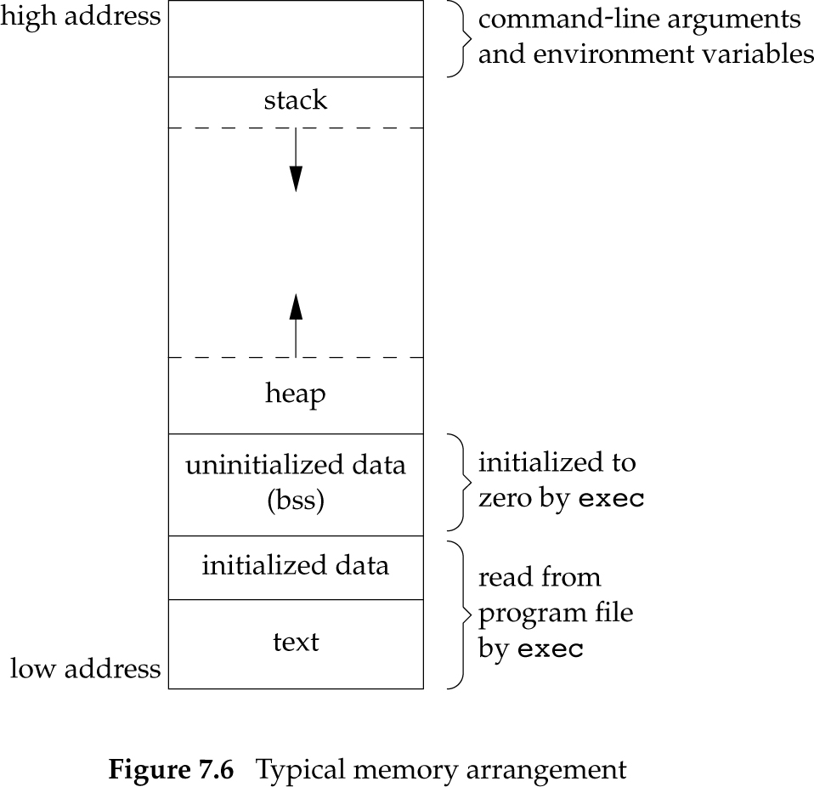
Memory Layout (with Libraries)
CS392
Shared Libraries (.so)
Memory allocated by malloc
Global/static variables
Global/static variables
Your code

Slide 75
PIDs
CS392
Every process has a unique process ID (PID)
Non-negative integer
PID are assigned by the kernel
The ID of terminated process can be reused
The currently running processes can be listed using the ps command
$ ps
21271 pts/0 00:00:00 bash
21308 pts/0 00:00:00 ps

Slide 76
Creating New Processes
pid_t fork();
Create a child process
The child is copy of the parent (calling) process
Both the parent and child resume execution in the instruction following fork()
But a different value is returned in each case
0 -> in the child process
Child PID -> in the parent process
CS392

Slide 77
Waiting for Children
CS392
pid_t wait(int *status);
Wait for the status of a child process to change
For example, the child terminated, was stopped, etc.
Return the pid of the child
status contains information on the state change

Slide 78
Zombie Processes
CS392
A zombie process or defunct process is a process that has completed execution but still has an entry in the process table
This occurs when child processes exit but the parent has yet to read the exit status via wait.
Once the exit status is read via the wait system call, the zombie's entry is removed from the process table and it is said to be "reaped".
A child process always first becomes a zombie before being removed from the resource table.
Processes that stay zombies for a long time are generally an error and cause a resource leak.

Slide 79
Zombie Processes
CS392
Always wait for your children!

Slide 80
Orphan Processes
CS392
An orphan process is a computer process whose parent process has finished or terminated, though it remains running itself.

Slide 81
exec
CS392
The exec() family of functions replaces the current process image with a new process image.

Slide 82
A Signal Is
CS392
A notification of an events that gain attention of the OS
Hardware generated faults/exceptions
Operating system/software generated faults/exceptions
Explicitly by a requesting process to another
What happens then
OS stops the application process immediately, sending it a signal
Signal handler executes to completion
Application process resumes where it left off

Slide 83
Default Actions
CS392
By default each signal has a default action associated with it
Default actions
Term Default action is to terminate the process.
Ign Default action is to ignore the signal.
Core Default action is to terminate the process and dump core.
Stop Default action is to stop the process.
Cont Default action is to continue the process if it is currently stopped.

Slide 84
The Modern Way
CS392
int sigaction(int signum, const struct sigaction *act, struct sigaction *oldact);
Examine and change the action to take on receipt of a signal signum
act → New action to take, if not null
oldact → Stores the previous action, if not null
Function to be called when signal is received
struct sigaction {
void (*sa_handler)(int);
void (*sa_sigaction)(int, siginfo_t *, void *);
sigset_t sa_mask;
int sa_flags;
void (*sa_restorer)(void);
};

Slide 85
sa_sigaction
CS392
sa_flags is a set of bit flags
Setting SA_SIGINFO in sa_flags will cause the use sa_sigaction instead of sa_handler
Never set both sa_handler and sa_sigaction
struct sigaction {
void (*sa_handler)(int);
void (*sa_sigaction)(int, siginfo_t *, void *);
sigset_t sa_mask;
int sa_flags;
void (*sa_restorer)(void);
};
Notes:
If SA_SIGINFO is specified in sa_flags, then sa_sigaction (instead of
sa_handler) specifies the signal-handling function for signum. This
function receives the signal number as its first argument, a pointer to
a siginfo_t as its second argument and a pointer to a ucontext_t (cast
to void *) as its third argument. (Commonly, the handler function
doesn't make any use of the third argument. See getcontext(3) for fur-
ther information about ucontext_t.)

Slide 86
Send Signal (1)
CS392
raise()
int raise(int iSig);
Commands OS to send a signal of type iSig to current process
Returns 0 to indicate success, non-0 to indicate failure
Example
int ret = raise(SIGINT); /* Process commits suicide. */
assert(ret != 0); /* Shouldn't get here. */
Note: C90 function

Slide 87
Send Signal (2)
CS392
kill()
int kill(pid_t iPid, int iSig);
Sends a iSig signal to the process whose id is iPid
Equivalent to raise(iSig) when iPid is the id of current process
Editorial comment: Better function name would be sendsig()
Example
pid_t iPid = getpid(); /* Process gets its id.*/
kill(iPid, SIGINT); /* Process sends itself a
SIGINT signal (commits
suicide?) */
Note: POSIX (not C90) function

Slide 88
IPC
CS392
A set of programming interfaces that allows coordinated activities between processes

Slide 89
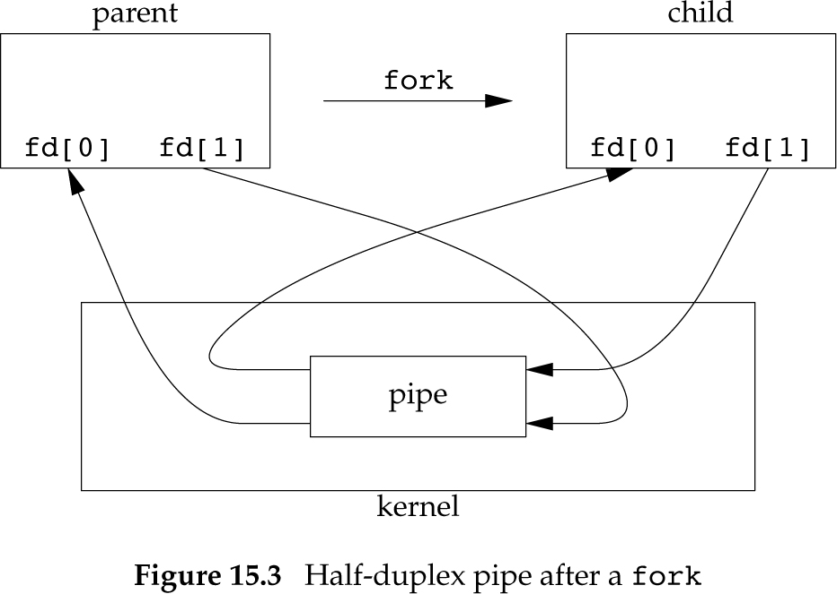
UNIX Pipes
CS392
Pipes are the oldest form of UNIX System IPC and are provided by all UNIX systems
Pipes can be used only between processes that have a common ancestor
Normally, a pipe is created by a process, that process calls fork, and the pipe is used between the parent and the child

Slide 90
Creating a Pipe
CS392
#include <unistd.h>
int pipe(int fd[2]);
Two file descriptors are returned through the fd argument:
fd[0] is open for reading
fd[1] is open for writing.
The output of fd[1] is the input for fd[0].

Slide 91
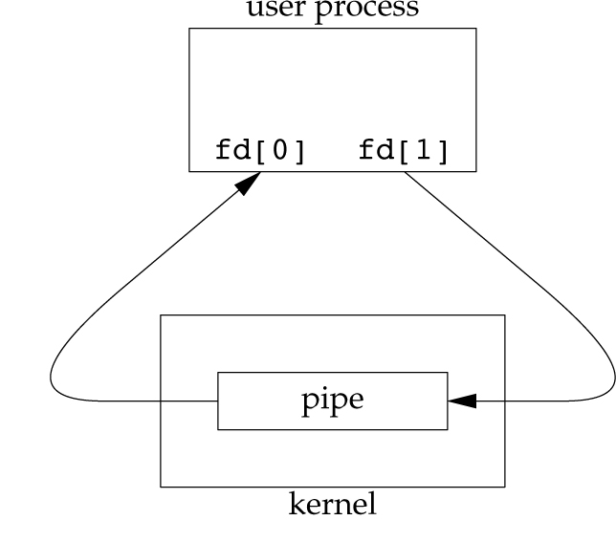
A Pipe is Provided by the OS
#include <unistd.h>
int pipe(int fd[2]);
Two file descriptors are returned through the fd argument:
fd[0] is open for reading
fd[1] is open for writing
The output of fd[1] is the input for fd[0].
CS392

Slide 92
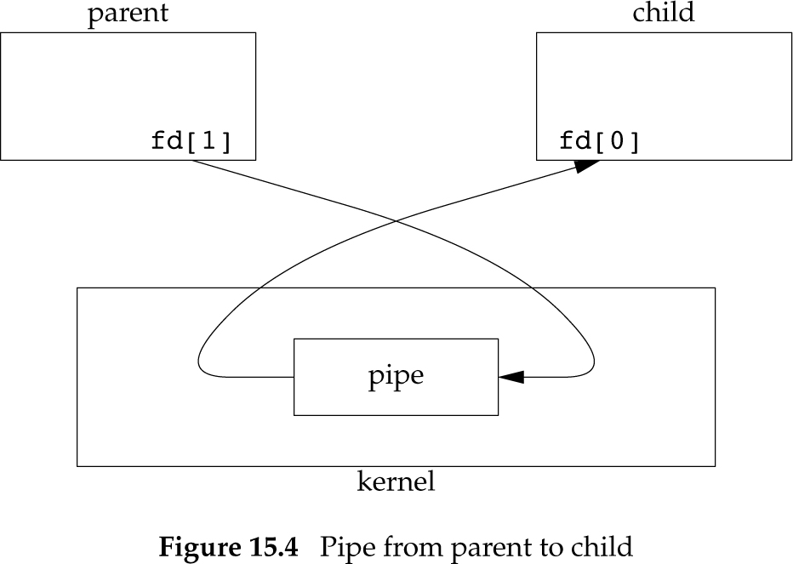
Half-duplex
CS392
Reading process should close fd[1] and use fd[0] for reading
Writing process should close fd[0] and use fd[1] for writing

Slide 93
Redirecting STDIO to a Pipe
Remember dup2()
#include <unistd.h>
int dup(int oldfd);
int dup2(int oldfd, int newfd);
CS392

Slide 94
Redirecting STDIO to a Pipe
CS392
dup2(fd[1], STDOUT_FILENO);
dup2(fd[0], STDIN_FILENO);

Slide 95
How to Create Full-duplex
CS392
Process A
Process B
http://www.cs.loyola.edu/~jglenn/702/S2005/Examples/dup2.html

Slide 96
Shared memory
CS392
Shared memory allows two or more processes to share a given region of memory
This is the fastest way for processes to exchange data
No data copying required
Nor system calls
This achieves bi-directional communications

Slide 97
Shared memory
CS392
Shared memory can be attached to different addresses.
Processes that have this memory segment attached will have access to it.

Slide 98
API to Create Share Memory
Create using int shmget(key_t key, size_t size, int flag);
key – identification of the shared memory
So different processes can find the shared memory
size – the size of the shared memory to be created
Rounded up to be a multiple of PAGE_SIZE (usually 4096)
flag – Flags to control the behaviors of this interface
To create a shared memory, use IPC_CREATE, IPC_EXCL and mode permissions (e.g., 0666)
How to create a key?
key_t ftok(const char *pathname, int proj_id);
The ftok() function uses the identity of the file named by the given pathname (which must refer to an existing, accessible file) and the least significant 8 bits of proj_id (which must be nonzero) to generate a key_t type System V IPC key
The same leads to the same key
CS392

Slide 99
Attaching to Shared Memory
void *shmat(int shmid, const void *addr, int flag);
Attach shared memory segment to process
shmid – ID returned from shmget
addr == NULL
The OS picks an address and attaches shared memory there
addr != NULL
Attach to the specific address addr. It should be a page aligned address unless flag SHM_RND is specified, which rounds it
flag – control the behaviors of shmat () (https://linux.die.net/man/2/shmat)
CS392

Slide 100
Detaching Memory
CS392
int shmdt(const void *shmaddr);
Detach segment at address shmaddr

Slide 101
Deleting Shared Memory
int shmctl(int shmid, int cmd, struct shmid_ds *buf );
cmd - IPC_RMID
IPC_RMID – remove the memory segment
CS392

Slide 102

How To Create A Daemon
Call fork and have the parent exit
init becomes the process’ parent
The child is not a process group (PG) leader
Call umask() to set file creation mask to a fixed value (for example, 0)
Create a new session, by calling setsid()
Becomes a session and PG leader
Process is disassociated from controlling terminal
Change current directory to “/” or some fixed directory for the service
Close unneeded file descriptors, such as 0, 1, 2
CS392
Please go to the lecture slides for details (why we need each step)

Slide 103
Part 7 – Threads
CS392

Slide 104
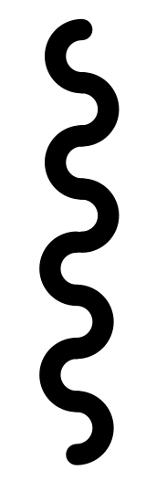
Single-threaded Processes
CS392
A process by default has a single thread of execution/control
A thread corresponds to an executing context or task
Threads have their own run-time context (e.g., program counter or instruction pointer)
Each thread has its own ID →thread ID (TID)
The kernel schedules tasks/threads for execution
Process
Thread

Slide 105
Multithreading
CS392
Process
A process can have multiple threads executing concurrently
They share the same address space and resources as the process
Can cause various concurrency issues when multiple threads read/write the same data concurrently
They are considered more lightweight than processes
Thread
Thread

Slide 106
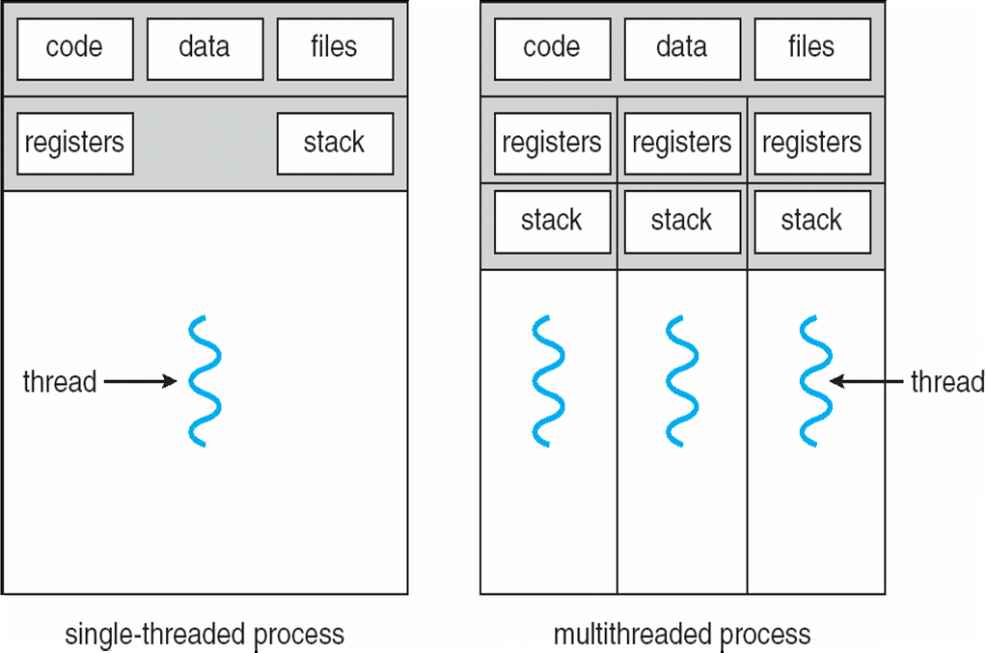
Process V.S. Thread
CS392

Slide 107
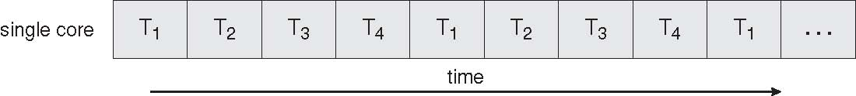
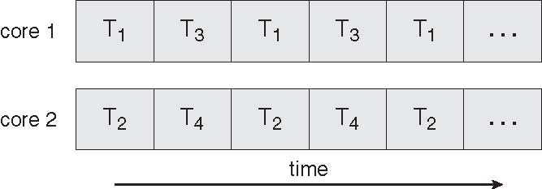
Concurrent Execution on a Single-core System
CS392
Parallel Execution on a Multicore System

Slide 108
More Benefits
CS392
Responsiveness
Allows a program continue running if part of it is blocked or its is performing a lengthy operation
Resource Sharing
Threads share the memory and the resources of the parent process
Economy
In Solaris, creating a process is 30 times slower than creating a thread, context switching is 5 times slower.
Scalability
Multithreading on a multi-CPU machine increase parallelism

Slide 109
Creating Threads
CS392
pthread_create
#include <pthread.h>
int pthread_create(pthread_t *thread, const pthread_attr_t *attr, void *(*start_routine) (void *), void *arg);
The pthread_create() function starts a new thread in the calling process. The new thread starts execution by invoking start_routine(); arg is passed as the sole argument of start_routine().
Compile and link with -pthread.

Slide 110

Exiting a Thread
CS392
static void *run_thread(void *arg)
{
printids();
return NULL;
}
static void *run_thread(void *arg)
{
printids();
void pthread_exit(NULL);
}
void pthread_exit(void *rval_ptr);
The pthread_exit() function terminates the calling thread and returns a value via retval that (if the thread is joinable) is available to another thread in the same process that calls pthread_join(3).
Calling exit(), _exit, or _Exit() will terminate the process and all of its threads!

Slide 111
Joining with Terminated Threads
CS392
pthread_create
#include <pthread.h>
int pthread_join(pthread_t thread, void **retval);
The pthread_join() function waits for the thread specified by thread to terminate. If that thread has already terminated, then pthread_join() returns immediately. The thread specified by thread must be joinable.
Compile and link with -pthread.

Slide 112
Race Condition
CS392
A “race condition” arises if two or more threads access the same variables or objects concurrently and at least one does updates
The result is dependent on the thread scheduling algorithm, i.e. both threads are "racing" to access/change the data.

Slide 113
Mutex -- Avoid Race Conditions
A mutex is a program object that enables multithreaded programs to access a shared resource through mutual exclusion
POSIX threads support mutex variables which can be used as locks
Concurrency control is achieved by allowing only one thread to obtain a lock
pthread_mutex_t mutex_variable;
Mutex variables must be initialized before being used and destroyed when you are done with it
CS392

Slide 114
Mutex Variables Initialization
int pthread_mutex_init(pthread_mutex_t *restrict mutex, const pthread_mutexattr_t *restrict attr);
Initialises the mutex referenced by mutex with attributes specified by attr. If attr is NULL, the default mutex attributes are used
Attempting to initialise an already initialised mutex results in undefined behaviour.
E.g., pthread_mutex_init(&lock, NULL);
CS392

Slide 115
Destroying a Mutex Variable
int pthread_mutex_destroy(pthread_mutex_t *mutex);
Destroy the mutex object referenced by mutex; the mutex object becomes, in effect, uninitialized.
E.g., pthread_mutex_destroy(&lock);
CS392

Slide 116
How to Use an Initialized Mutex
Lock a mutex, block if another thread has locked it instead
int pthread_mutex_lock(pthread_mutex_t *mutex);
Lock a mutex, return 0 if mutex was successfully locked, an error code otherwise (e.g., mutex alredy locked)
Use when you do not want to block
int pthread_mutex_trylock(pthread_mutex_t *mutex);
Unlock/release a mutex
int pthread_mutex_unlock(pthread_mutex_t *mutex);
CS392

Slide 117
Deadlocks
CS392
A deadlock is a situation where no progress can be made because usually two actions are waiting for each other

Slide 118
Deadlocks
CS392
A deadlock is a situation where no progress can be made because usually two actions are waiting for each other
A deadlock can occur:
when the same thread attempts to lock the same mutex twice
pthread_mutex_lock(&st->lock);
…..
pthread_mutex_lock(&st->lock);
// Same Thread
The thread will block forever

Slide 119
Deadlocks
CS392
A deadlock is a situation where no progress can be made because usually two actions are waiting for each other
A deadlock can occur:
When the same thread attempts to lock the same mutex twice
But can be more complex when multiple locks are involved

Slide 120
Part 8 – Sockets
CS392

Slide 121
Sockets
int socket(int domain, int type, int protocol);
domain defines the address family
AF_INET – IPv4 (most commonly used )
AF_INET6 – IPv6 (the future!!is here )
AF_UNIX – UNIX domain (covered)
AF_UNSPEC – unspecified
type specifies the communication semantics
SOCK_STREAM Provides sequenced, reliable, two-way, connection- based byte streams.
SOCK_DGRAM Supports datagrams (connectionless, unreliable messages of a fixed maximum length).
SOCK_SEQPACKET Provides a sequenced, reliable, two-way connection- based data transmission path for datagrams of fixed maximum length
Protocol: specific protocol(Usually 0 )
UNSPEC: unspecified
(AF_INET and SOCK_STREAM already implies TCP, ‘’0’’ setting protocol)
CS392

Slide 122
Socket Identification ``endpoint address’’
Socket Identification: IP Address + Port Number
Receiving host
Destination address that uniquely identifies the host
An IP address is a 32-bit quantity( for IPV4)
128 IP address for IPV6 why??
Receiving socket
Host may be running many different processes
Destination port that uniquely identifies the socket
A port number is a 16-bit quantity
You have probably encountered it
Eg 192.168.1.1:8080, 147.89.33.127:8080 or…
http:://localhost:8080 … or ping www.google.com…
CS392

Slide 123
Using Ports to Identify Services
CS392
Server host 128.2.194.242
Service request for
128.2.194.242:80
(i.e., the Web server)
Client host
Web server
(port 80)
Client
OS
Echo server
(port 7)
Service request for
128.2.194.242:7
(i.e., the echo server)
Web server
(port 80)
Client
OS
Echo server
(port 7)

Slide 124
Client-Server Communication Datagram Sockets (UDP): Connectionless
CS392
Server
Client
Create a socket
Create a socket
Bind the socket
Bind the socket
data (request)
Receive Request
Send the request
data (reply)
Send response
Receive response

Slide 125
Client-Server Communication Stream Sockets (TCP): Connection-oriented
Server
CS392
Create a socket
Bind the socket
(what port am I on?)
Client
Listen for client
(Wait for incoming connections)
Create a socket
establish connection
Connect to server
Accept connection
data (request)
Send the request
Receive Request
Send response
data (reply)
Receive response

Slide 126
Part 9 – Permissions
CS392

Slide 127
Users and Groups cont.
User information in /etc/passwd
Password info is in /etc/shadow
Group information is in /etc/group
/etc/passwd and /etc/group divide data fields using “:”
/etc/passwd:
joeuser:x:1000:1000:Joe User,,,:/home/joeuser:/bin/bash
/etc/group:
joeuser:x:1000:
CS392

Slide 128
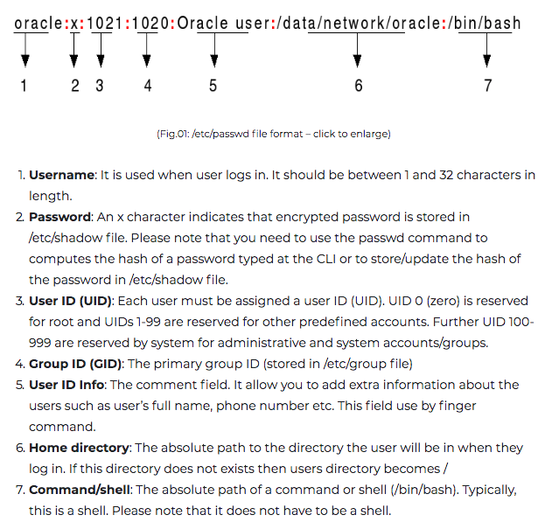
/etc/passwd
CS392

Slide 129
File Ownership
CS392
A file can belong to only one user and one group at a time
Only root can change the ownership of a file

Slide 130
File Permissions
CS392
Each file and directory has bits for..
Read, Write, Execute: rwx
Directories:
r → “can list files in a directory” (but not read a given file)
x → “read a file if you know the name” (easy if directory also has read)
w → “can create, change, delete files in directory”
Thus, you may only read a file IFF you:
Have read permissions to the file AND
Have execute permissions to that file’s directory
Files & Directories have 3 levels:
Owner, Group, and Everyone Else
aka. User, Group, Other: ugo

Slide 131
CS392
-r-xr-xr-x 1 root root 68524 2011-12-19 07:18 /usr/bin/top
---------- --- ------- ------- -------- ------------ -------------
| | | | | | |
| | | | | | File Name
| | | | | |
| | | | | +--- Modification Time/Date
| | | | |
| | | | +------------- Size (in bytes
| | | |
| | | +----------------------- Group
| | |
| | +-------------------------------- Owner
| |
| +-------------------------------------- “link count”
|
+---------------------------------------------- File Permissions
Group
The name of the group that has permissions in addition to the file's owner.
Owner
The name of the user who owns the file.
File Permissions
The first character is the type of file. A "-" indicates a regular (ordinary) file. A "d” indicate a directory. Second set of 3 characters represent the read, write, and execution rights of the file's owner. Next 3 represent the rights of the file's group, and the final 3 represent the rights granted to everybody else.
(Example modified from http://www.linuxcommand.org/lts0030.php)

Slide 132
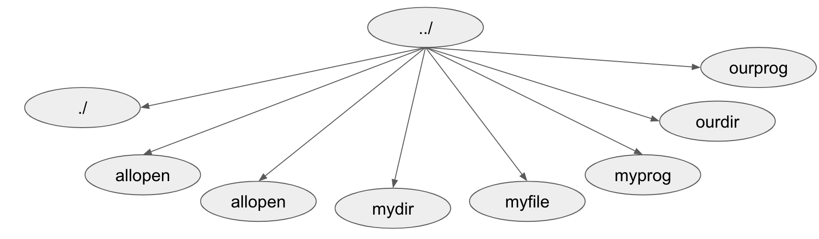
List permissions of a file: ls –l with some info removed from below in [...] drwx--x--- […] andy faculty […] . drwx------ […] andy faculty […] .. -rwxrwxrwx […] andy faculty […] allopen drwx------ […] andy faculty […] mydir -rw------- […] andy faculty […] myfile -rwx------ […] andy faculty […] myprog drwxrwx--- […] andy faculty […] ourdir -rwxrwx--- […] kenn faculty […] ourprog
Can kenn execute myprog?
No, because of file permissions.
Can both andy and kenn execute ourprog?
Yes. Everyone in faculty can read and execute ourprog
Can kenn read ourprog?
Yes. Directory has group x, file has group r
Can kenn list to find ourprog?
No. Directory listing is off.
CS392

Slide 133
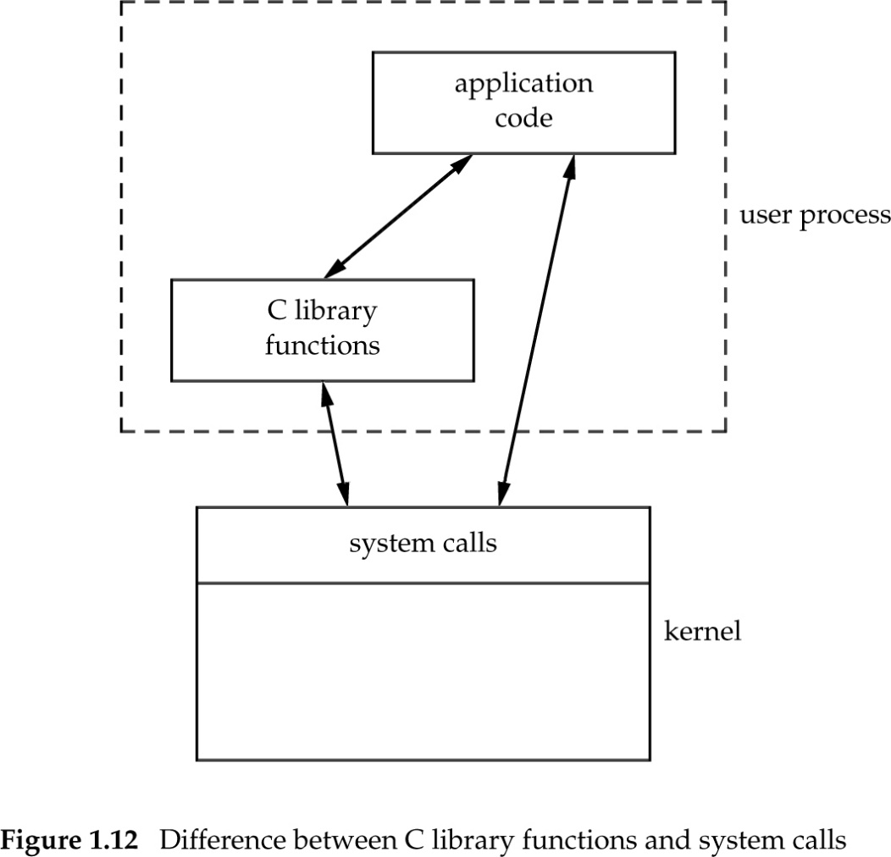
Function vs System Calls
CS392

Slide 134
Thank You So Much!
I really enjoy my first semester of teaching, with such a group of awesome students!
I really appreciate the helps from all of you, and I also learned a lot from you！
I wish you all a best future and of course, you can email me if you have any questions related to computer systems ☺

